Slide 1
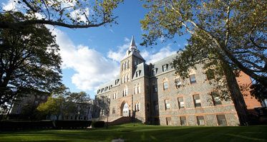
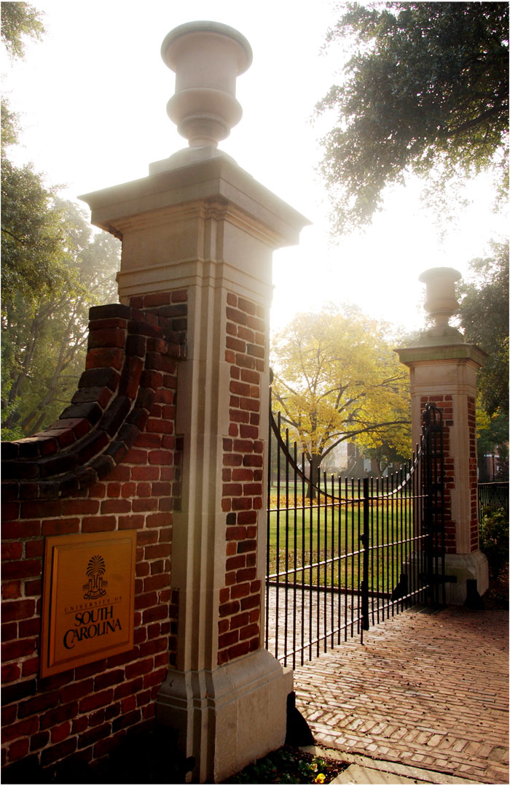
Structure, Governance and Operations:
Differentiators in US and Greek Universities
George Korfiatis
Michael Amiridis
First Greece-U.S. Academic Meeting
Washington DC January 14-15, 2011
Notes:
New to Stevens, kind of….
Insider / Outsider perspective
My role here is to drive enrollment through building out brand and sharing ideas
Externally: The idea of Stevens - our story and our offerings
Internally: The idea of leveraging our efforts and resources in marketing
This presentation is about those 2 ideas and the things we need to focus on to share them successfully.
Note: Integrated Marketing is a process that allows an organization to concentrate its limited resources on the greatest opportunities to increase revenue and achieve a sustainable competitive advantage. Its about multiplying and reinforcing our strengths and efforts.

Slide 2
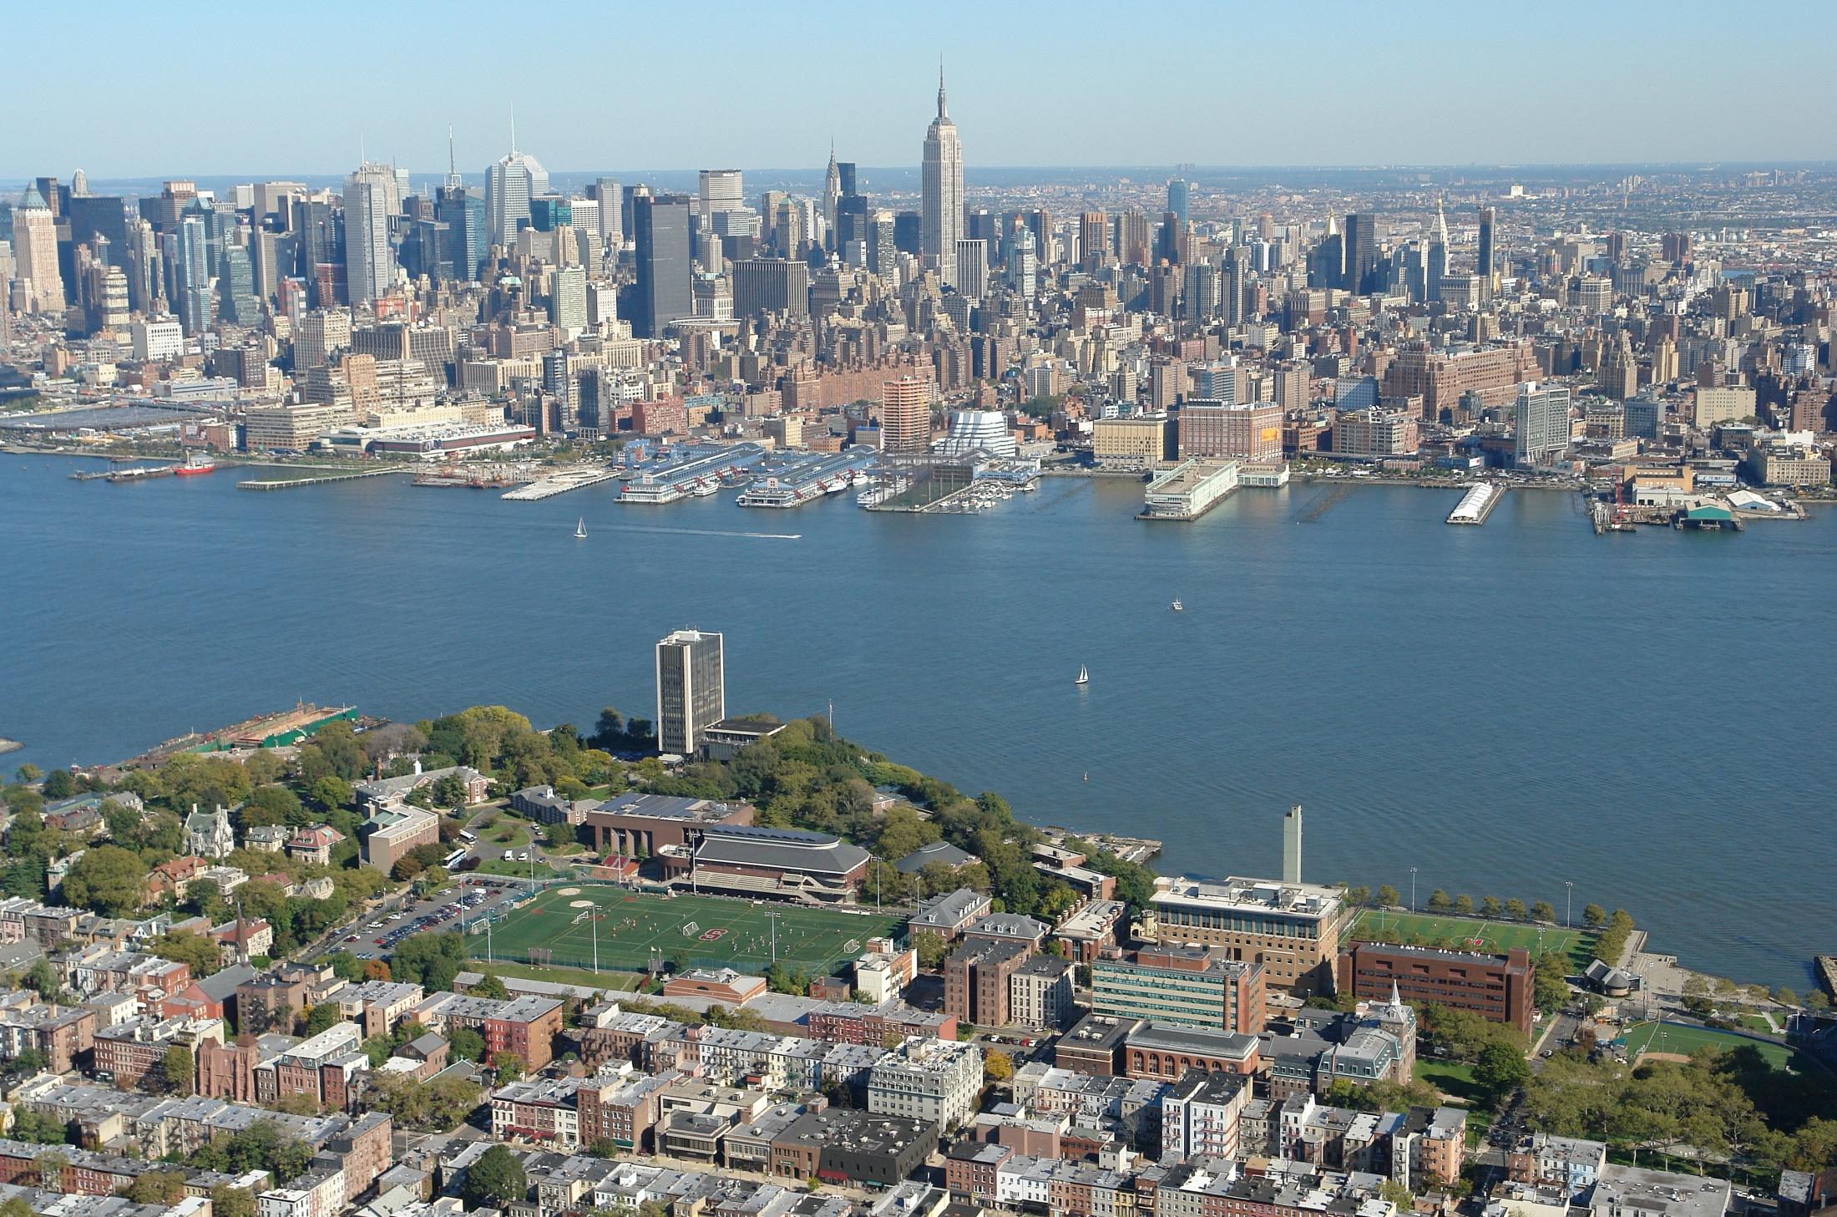
STEVENS INSTITUTE OF TECHNOLOGY
Notes:
Building an integrated marketing process, in any organization is this is a long term process but may have the most profound impact of all the things we discuss today because it will align our efforts and lead to greater brand awareness and operational efficiency.

Slide 3
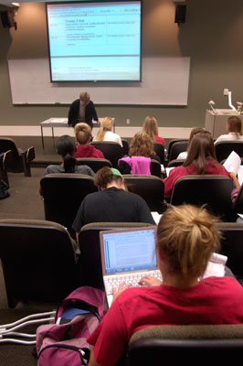
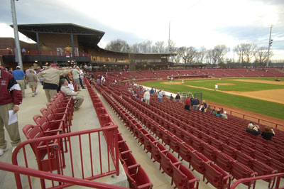
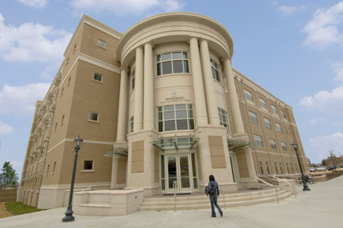
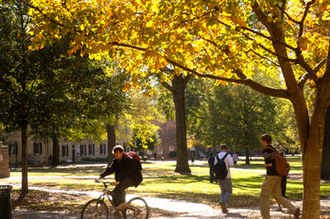
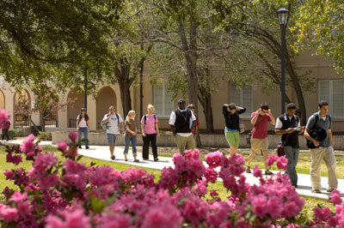
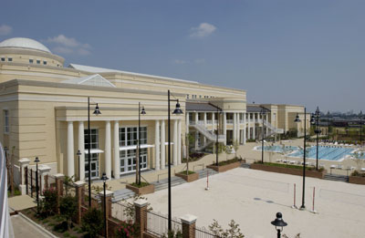
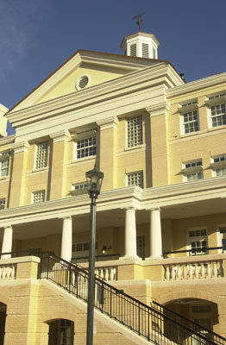
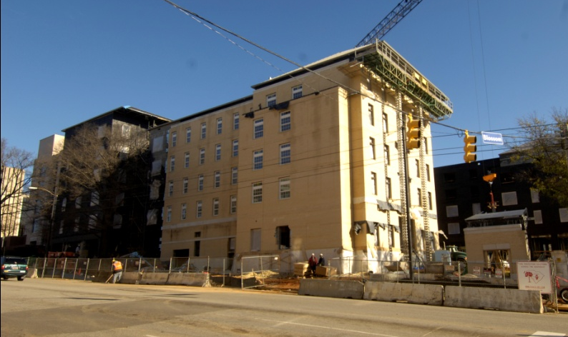
Notes:
We have a lot of quality – facilities, appearance
In fact, I believe the single most important reason why Carolina has made such progress over the last decade is its attention to the quality.
But quality will need to be advanced even more.
We will need quality in our classrooms, technology, research labs, other buildings and facilities – appearance
If we fail to emphasize quality, all of our other qualitative goals are in jeopardy

Slide 4
DIFFERENTIATORS- MISSION AND FUNCTION Source: Carnegie Foundation
TYPE | Public | PRIVATE NFP | PRIVATE FP | TOTALS
ASSOCIATE DEGREES (2 YEAR) | 6,401,133 | 56,013 | 321,105 | 6,778,251
 | 1,078 | 134 | 602 | 1,814
RESEARCH UNIVERSITIES | 3,688,603 | 1,084,762 | 148,281 | 4,921,646
 | 167 | 108 | 8 | 283
MASTERS | 2,411,305 | 1,290,716 | 185,765 | 3,887,786
 | 267 | 352 | 44 | 663
BACCALAUREATE COLLEGES | 492,424 | 826,387 | 72,308 | 1,391,119
 | 152 | 541 | 74 | 767
SPECIAL AND PROFESSIONAL | 86,629 | 331,436 | 170,004 | 588,069
 | 68 | 603 | 167 | 838
TOTALS | 13,081,826 | 3,591,052 | 898,191 | 17,571,069
 | 1,732 | 1,738 | 895 | 4,365
Notes:
Building an integrated marketing process, in any organization is this is a long term process but may have the most profound impact of all the things we discuss today because it will align our efforts and lead to greater brand awareness and operational efficiency.

Slide 5
University Structure
BOARD OF TRUSTEES
Oversight
Corporate Structure
Management
PRESIDENT-
EXECUTIVE MANAGMENT
Administration
Academics
Auxiliaries and Support Structures
Schools/Colleges
Academic Departments/Divisions
Research Centers
Notes:
Building an integrated marketing process, in any organization is this is a long term process but may have the most profound impact of all the things we discuss today because it will align our efforts and lead to greater brand awareness and operational efficiency.

Slide 6
Board of Trustees
Members elected by the SC General Assembly
All members are graduates of the school
Long-term service is common
Fiduciary responsibility
President serves at their pleasure
Approve all VP appointments

Slide 7
Relationship with the State
State rules and regulations apply
Purchasing, HR, construction
Annual appropriation determined by the State
Transparency requirements
Contractual relationships with state agencies
Control of annual tuition raises

Slide 8
US-GREEK UNIVERSITY DIFFERENTIATORS
1-LEADERSHIP: SELECTION/APPOINTMENT
2- COMPETITION ON THE BASIS OF METRICS THAT ENHANCES REPUTATION WHILE MEETING MISSION GOALS
3-ACCREDITATION STRUCTURE/PROCESSES
4-STRATEGIC PLANNING AND ALIGNMENT -VISION
5-SELF ASSESSMENT AND EVALUATION
6-THE ROLE OF STUDENT BODY (ORGANIZATIONS) ON GOVERNANCE
Notes:
Building an integrated marketing process, in any organization is this is a long term process but may have the most profound impact of all the things we discuss today because it will align our efforts and lead to greater brand awareness and operational efficiency.

Slide 9
LARGE SCALE ISSUES
1- Emergence of Private for Profit Universities
2- Online Education
3- Third Party Rankings
4- Global Presence/Global Competition
5- Role of Modern University in a Knowledge Economy
6- Pushing the Envelope of Research/Exploitation of IP
7- Cost of Education
Notes:
Building an integrated marketing process, in any organization is this is a long term process but may have the most profound impact of all the things we discuss today because it will align our efforts and lead to greater brand awareness and operational efficiency.

Slide 10
State Accountability
Accessibility and affordability for in-state students
Retention and graduation rates
Impact on economic development

Slide 11
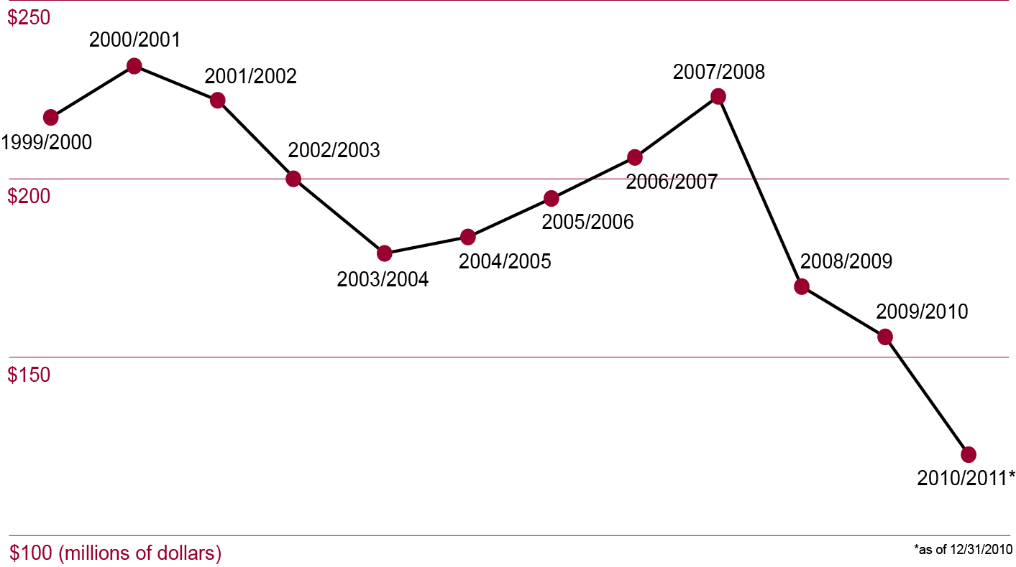
State Appropriations 1999-2011

Slide 12
FY11 Total Current Funds Revenue Budget
USC Columbia

Slide 13
Total Current Funds Revenue Sources

Slide 14
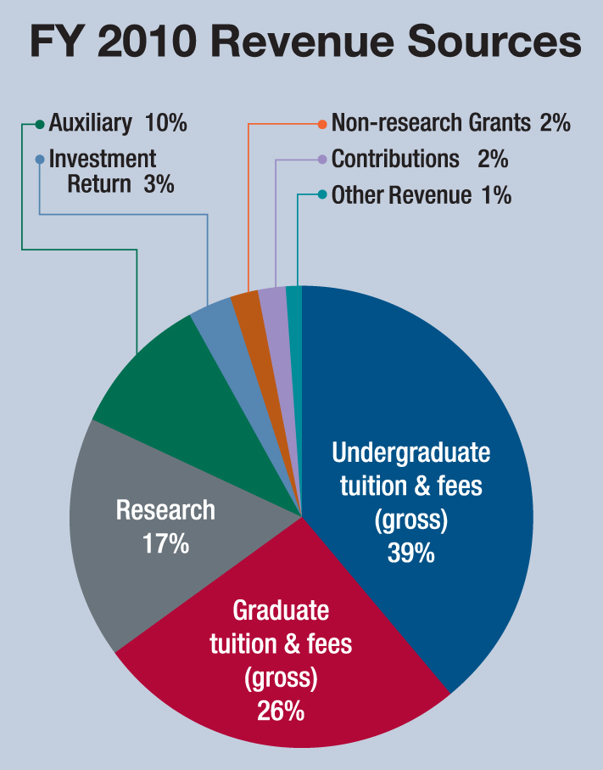
STEVENS
Notes:
Building an integrated marketing process, in any organization is this is a long term process but may have the most profound impact of all the things we discuss today because it will align our efforts and lead to greater brand awareness and operational efficiency.

Slide 15
Budgeting under Crisis
Adjusted enrollments
Raised tuition
Cut expenses
Eliminated programs
Eliminated staff positions
Increased teaching loads
Froze faculty hiring
Introduced furloughs

Slide 16
US-GREEK COLLABORATION
My philosophy:
Bottom-Up : Chemistry
Top-Down: Nurturing
Notes:
Building an integrated marketing process, in any organization is this is a long term process but may have the most profound impact of all the things we discuss today because it will align our efforts and lead to greater brand awareness and operational efficiency.

Slide 17
Notes:
New to Stevens, kind of….
Insider / Outsider perspective
My role here is to drive enrollment through building out brand and sharing ideas
Externally: The idea of Stevens - our story and our offerings
Internally: The idea of leveraging our efforts and resources in marketing
This presentation is about those 2 ideas and the things we need to focus on to share them successfully.
Note: Integrated Marketing is a process that allows an organization to concentrate its limited resources on the greatest opportunities to increase revenue and achieve a sustainable competitive advantage. Its about multiplying and reinforcing our strengths and efforts.

